Slide 1
CS112: Introduction to Python programming
Week 11: Pandas II

Slide 2
Pandas-Data Structures
Pandas provides two very useful data structures to process the data:
Series ： one-dimensional array
pd.Series(data, index=index)
通过index提取数据
DataFrame ： Two-dimensional array
pd.DataFrame(data, (index=[,], columns=[,]))
read_csv (filepath, sep=’,’ , header = ‘infer’, names = None, index_col = None,…)
df.loc[ row_lable, col_label ]
df[df[“sample1”]>1]

Slide 3
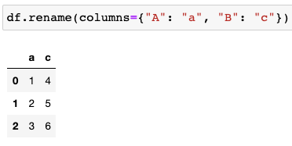
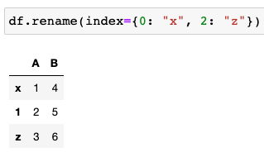
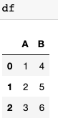
DataFrame attributes and methods
modify index / column names
DataFrame.rename()
Rename columns or index labels.

Slide 4
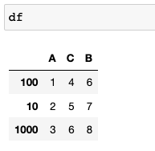
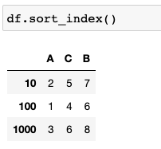
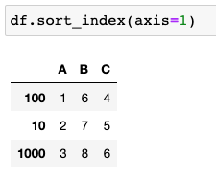
DataFrame attributes and methods
Sort index
DataFrame.sort_index(axis=0, ascending=True, inplace=False,…)
Sort object by labels (along an axis).

Slide 5
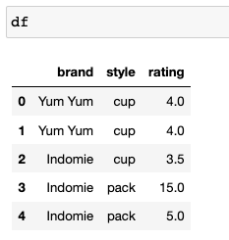
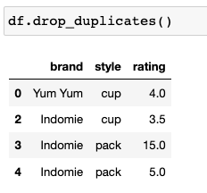
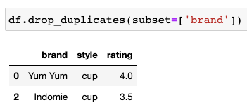
DataFrame attributes and methods
DataFrame.drop_duplicates(subset=None, *, keep='first', inplace=False, ignore_index=False)
Return DataFrame with duplicate rows removed.
By default, it removes duplicate rows based on all columns.
Keep: {‘first’, ‘last’, False}, default ‘first’
Drop duplicates

Slide 6
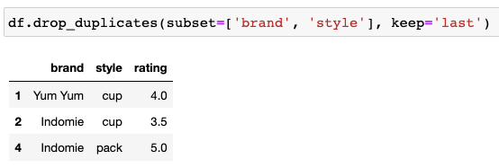
DataFrame attributes and methods
DataFrame.drop_duplicates(subset=None, *, keep='first', inplace=False, ignore_index=False)
Return DataFrame with duplicate rows removed.
By default, it removes duplicate rows based on all columns.
Keep: {‘first’, ‘last’, False}, default ‘first’
Drop duplicates

Slide 7
Apply functions to DataFrames
.apply( func, axis=0): allow the users to pass a function and apply it on every single value of the Pandas series
func :
function. Function to apply to each column or row.
axis:
0 or 'index': apply function to each column.
1 or 'columns': apply function to each row

Slide 8
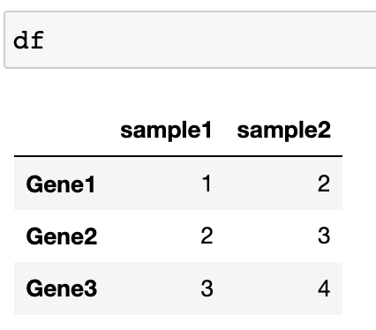
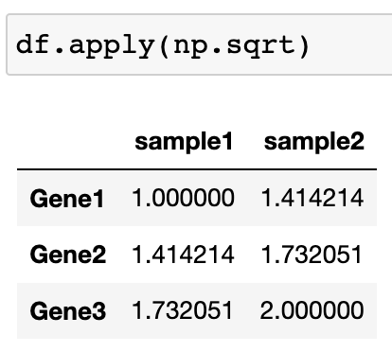
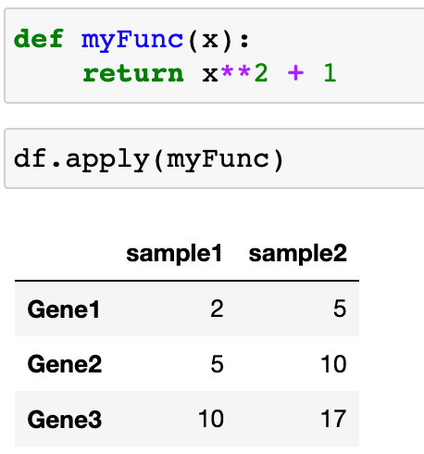
Apply functions to DataFrames
.apply( func, axis=0): allow the users to pass a function and apply it on every single value of the Pandas series

Slide 9
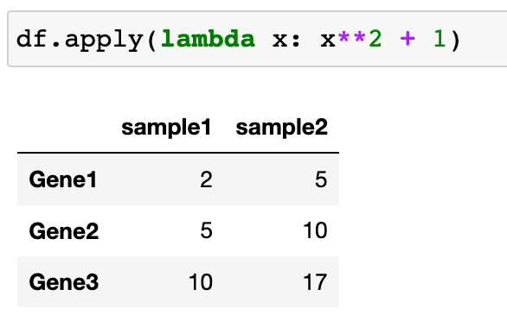
Apply functions to DataFrames
.apply( func, axis=0): allow the users to pass a function and apply it on every single value of the Pandas series

Slide 10
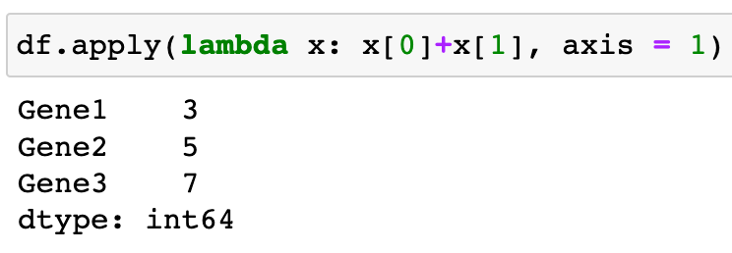
Apply functions to DataFrames
.apply( func, axis=0): allow the users to pass a function and apply it on every single value of the Pandas series

Slide 11
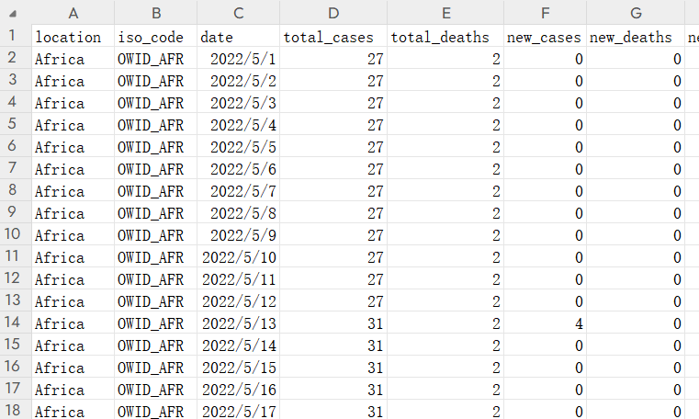
Pandas Datetime
Pandas has special tools for handling dates and times. They make use of the Python library datetime, which defines the datetime object:

Slide 12
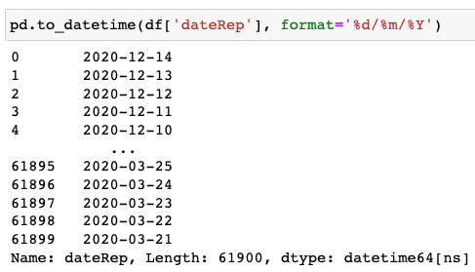
Pandas Datetime
pandas.to_datetime():
This function converts Series or DataFrame/dict-like to a pandas datetime object.
Code | Example | Code | Example
%a | Sun | %M | 06
%A | Sunday | %-M | 6
%w | 0 | %S | 05
%d | 08 | %-S | 5
%-d | 8 | %f | 000000
%b | Sep | %z | +0000
%B | September | %Z | UTC
%m | 09 | %j | 251
%-m | 9 | %-j | 251
%y | 13 | %U | 36
%Y | 2013 | %W | 35
%H | 07 | %c | Sun Sep 8 07:06:05 2013
%-H | 7 | %x | 09/08/13
%I | 07 | %X | 07:06:05
%-I | 7 | %% | %
%p | AM | https://strftime.org/

Slide 13
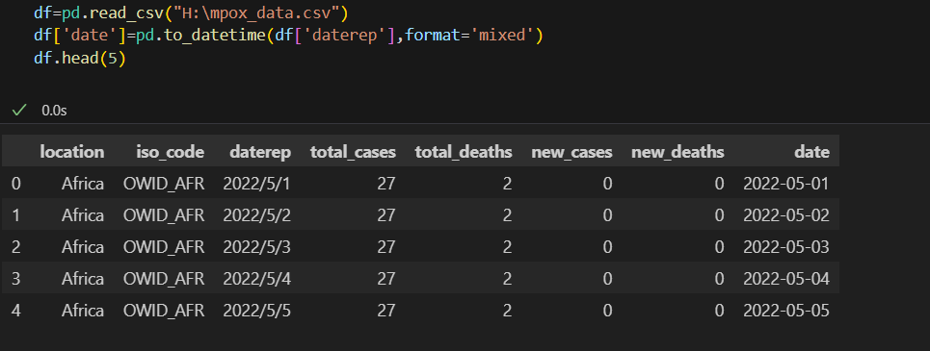
Pandas Datetime
pandas.to_datetime():

Slide 14
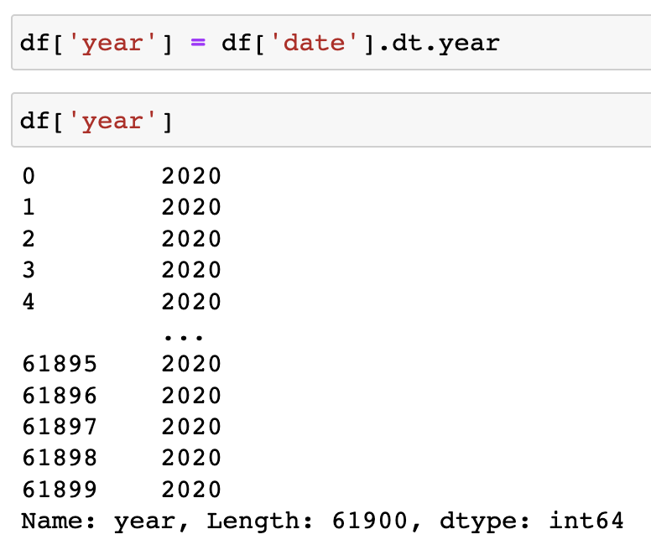
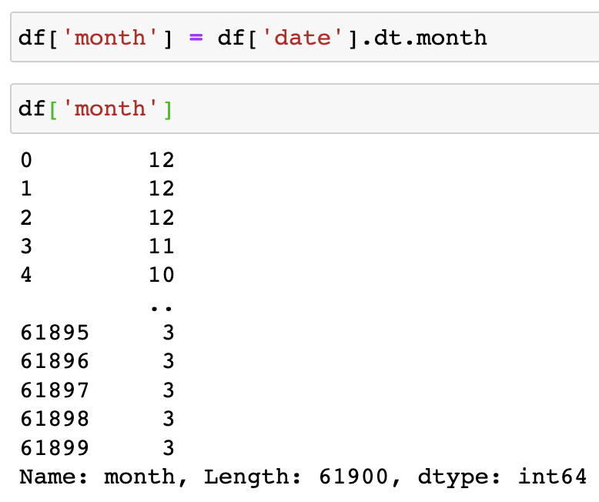
Pandas Datetime
pandas.Series.dt.year: returns the year of the date time.
pandas.Series.dt.month: returns the month of the date time.

Slide 15
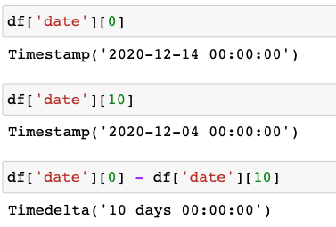
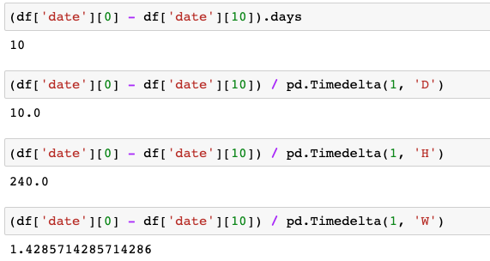
Pandas Datetime
pandas.Timedelta(value, unit=None, **kwargs)
Represents a duration, the difference between two dates or times.

Slide 16
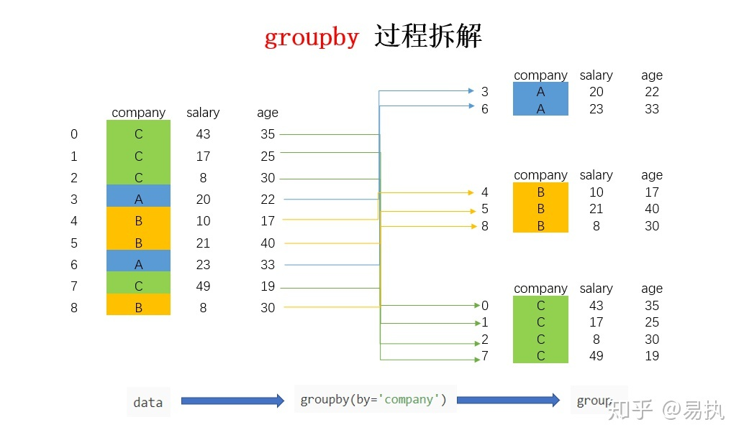
DataFrame Grouping
.groupby(by=None, axis=0):
split the data into groups
by: Used to determine the groups for the groupby. Can be Column names
df
df.groupby (‘company’)

Slide 17
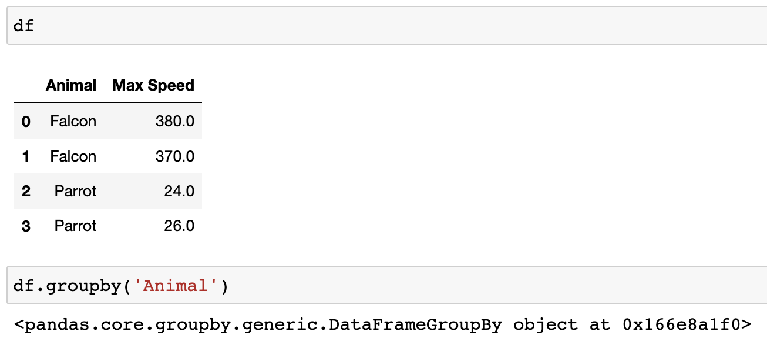
DataFrame Grouping
.groupby(by=None, axis=0):
split the data into groups

Slide 18
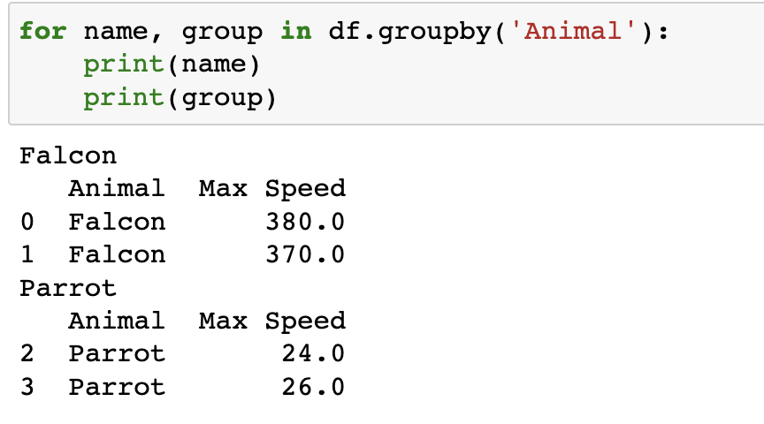
DataFrame Grouping
.groupby(by=None, axis=0):
split the data into groups
Iterate over groups

Slide 19
DataFrame Grouping
Applying function to group
Aggregation : Aggregation is a process in which we compute a summary statistic about each group after splitting a data into groups using groupby function.
.agg(func=None):
func: function, str, list or dict; Function to use for aggregating the data.
Accepted combinations are:
function: e.g. np.sum, np. mean, …
string function name : ‘min’, ‘max’, ‘sum’, ‘mean’, ‘median’ ,’count’,…
list of functions and/or function names, e.g. [np.sum, 'mean']
dict of axis labels -> functions, function names or list of such.

Slide 20
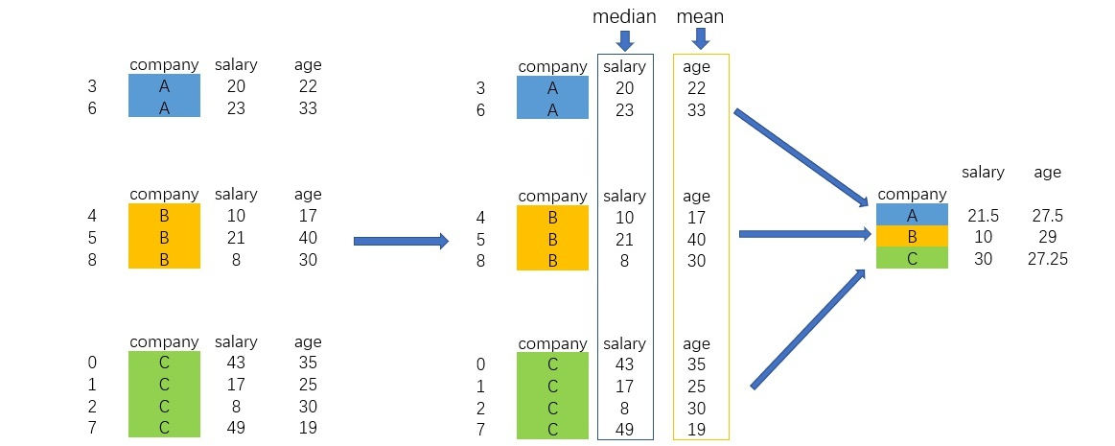
DataFrame Grouping
Applying function to group
df.groupby (‘company’)
df.groupby (‘company’).agg({‘salary’:’median’, ‘age’:’mean’})

Slide 21
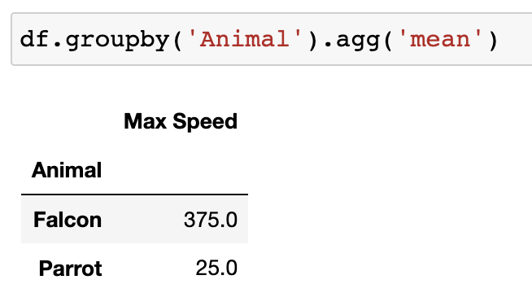
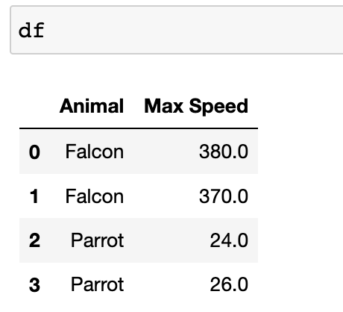
DataFrame Grouping
Applying function to group

Slide 22
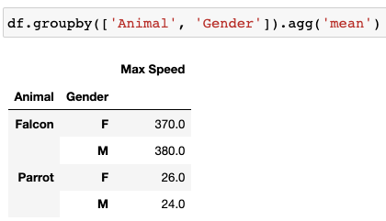
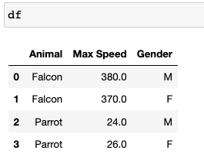
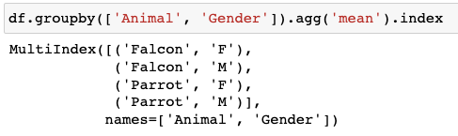
DataFrame Grouping
Group on multiple columns

Slide 23
DataFrame Grouping
Applying function to group
Transformation : Transformation is a process in which we perform some group-specific computations and returns an object that is indexed the same (same size) as the one being grouped.
.transform(func=None):
func: function: e.g. np.sum, np. mean, …
string function name : ‘min’, ‘max’, ‘sum’, ‘mean’, ‘median’ ,’count’,…
list of functions and/or function names, e.g. [np.sum, 'mean']
dict of axis labels -> functions, function names or list of such.

Slide 24
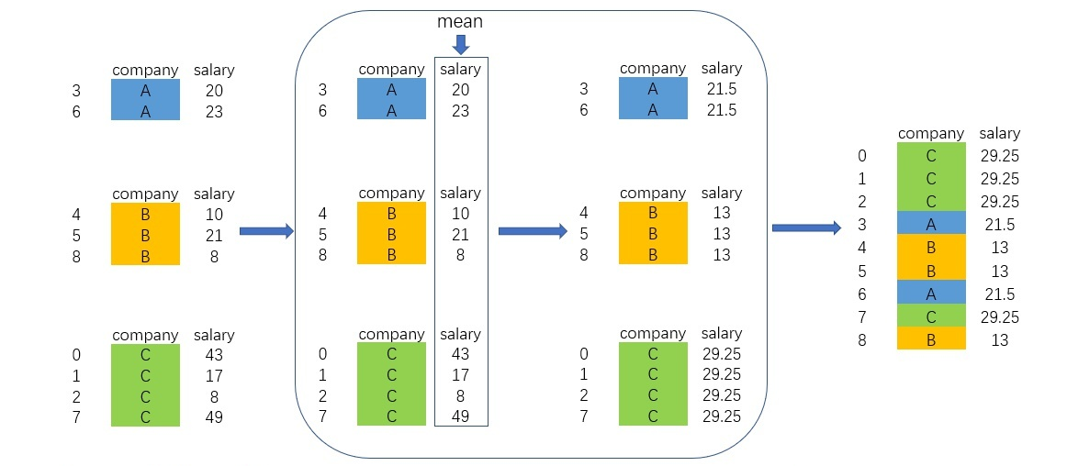
DataFrame Grouping
Applying function to group
df
df.groupby (‘company’)
df.groupby (‘company’).transform(‘mean’)

Slide 25
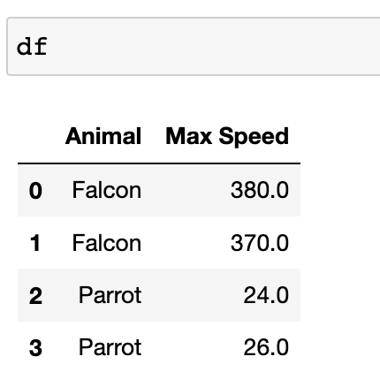
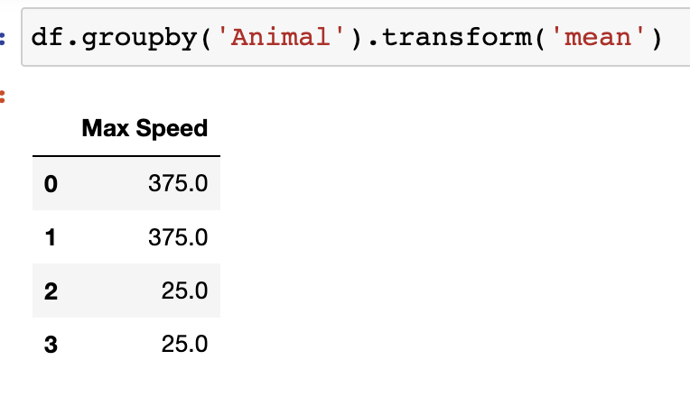
DataFrame Grouping
Applying function to group

Slide 26
DataFrame Grouping
Applying function to group
Apply : Apply a defined function to each sub-Dataframe after groupby
.apply(func=None):
func: function

Slide 27
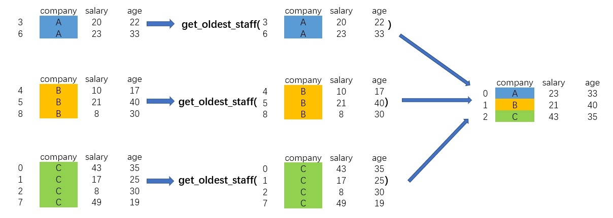
DataFrame Grouping
Applying function to group
df.groupby (‘company’)
df.groupby (‘company’).apply( get_olders_staff )

Slide 28
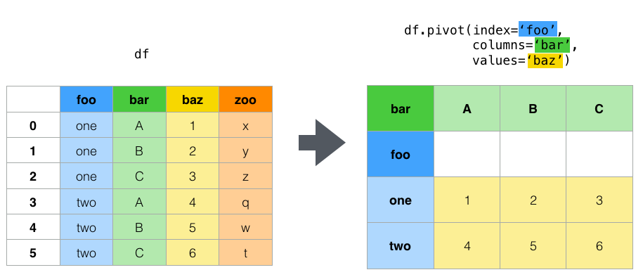
DataFrame Reshaping
df.pivot(index=None, columns=None, values=None)
Return reshaped DataFrame organized by given index / column values.
Reshape data (produce a "pivot" table) based on column values. Uses unique values from specified `index` / `columns` to form axes of the resulting DataFrame.
Long
Wide
Pivot

Slide 29
DataFrame Reshaping
df.pivot(index=None, columns=None, values=None)
Return reshaped DataFrame organized by given index / column values. Reshape data (produce a “pivot” table) based on column values. Uses unique values from specified index / columns to form axes of the resulting DataFrame.
columns: str or object or a list of str. Column to use to make new frame’s columns.
index: str or object or a list of str, optional. Column to use to make new frame’s index. If not given, uses existing index.
values: str, object or a list of the previous, optional. Column(s) to use for populating new frame’s values. If not specified, all remaining columns will be used and the result will have hierarchically indexed columns.

Slide 30
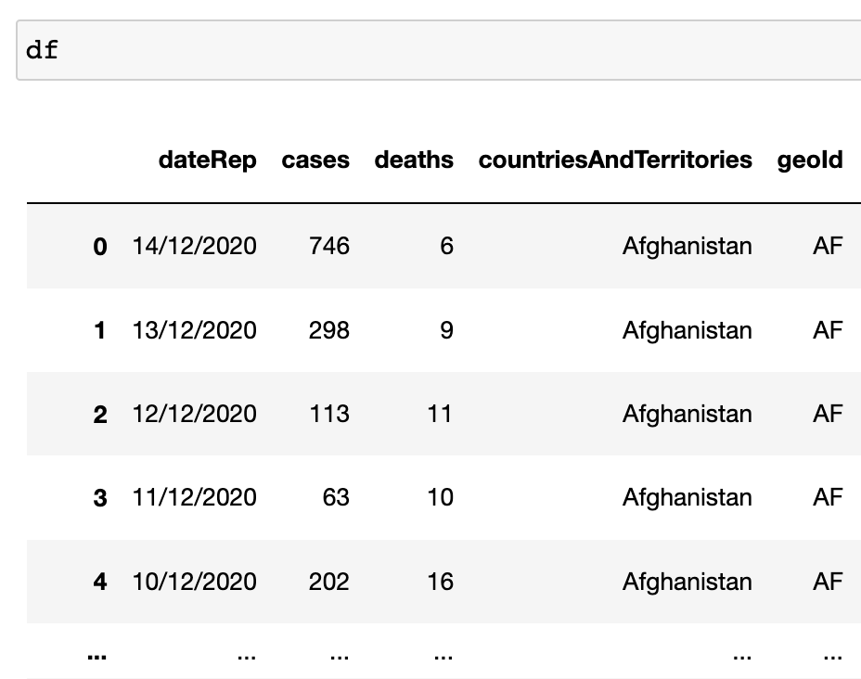
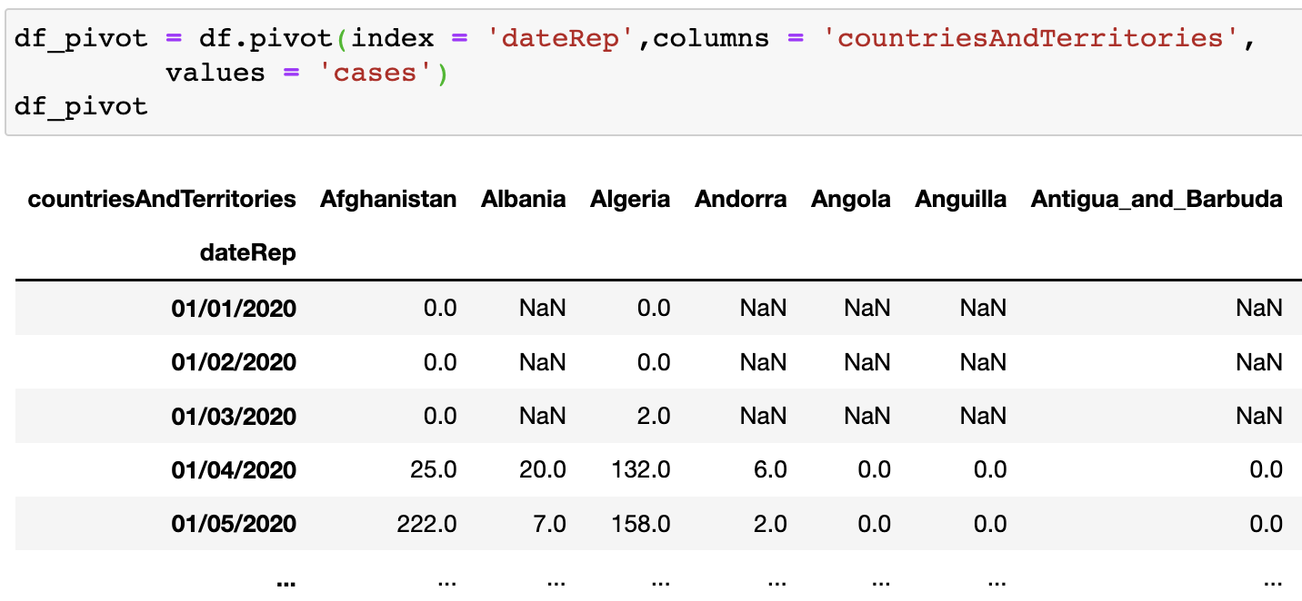
DataFrame Reshaping
df.pivot(index=None, columns=None, values=None)

Slide 31
DataFrame Reshaping
df.melt(id_vars=None, value_vars=None, var_name=None, value_name='value')
Unpivot a DataFrame from wide to long format
id_vars tuple, list, or ndarray, optional Column(s) to use as identifier variables.
value_vars tuple, list, or ndarray, optional Column(s) to unpivot. If not specified, uses all columns that are not set as id_vars.
var_name scalarName to use for the ‘variable’ column. If None it uses frame.columns.name or ‘variable’.
value_name scalar, default ‘value’Name to use for the ‘value’ column.
ignore_index bool, default TrueIf True, original index is ignored. If False, the original index is retained. Index labels will be repeated as necessary.

Slide 32
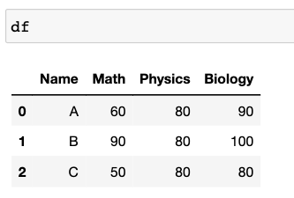
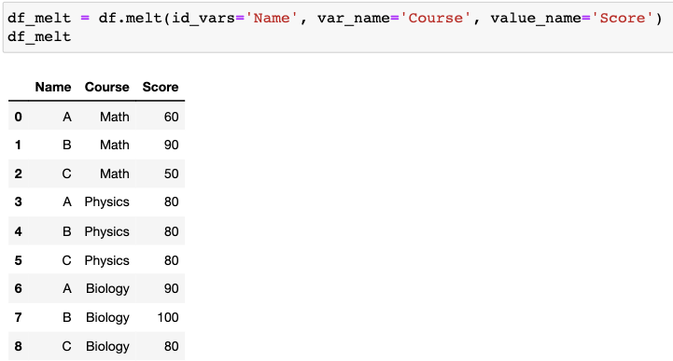
DataFrame Reshaping
df.melt(id_vars=None, value_vars=None, var_name=None, value_name='value')

Slide 33
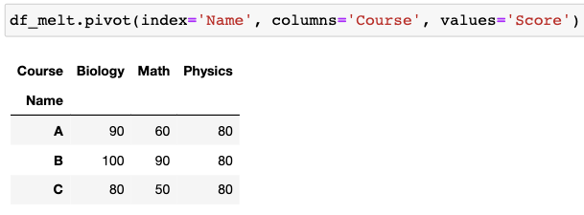
DataFrame Reshaping
df.melt(id_vars=None, value_vars=None, var_name=None, value_name='value')

Slide 34
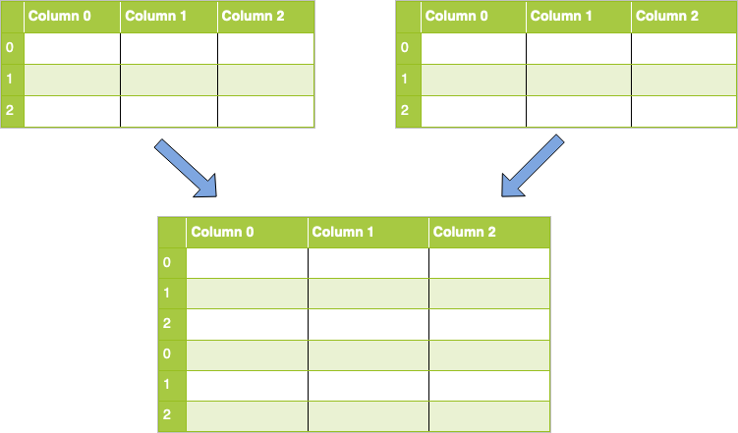
Combine DataFrames
pd.concat (objs, axis=0, join=‘outer’)
combine dataframes together along an axis — either the row axis or column axis.

Slide 35
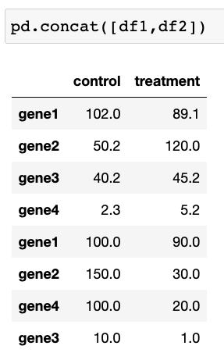
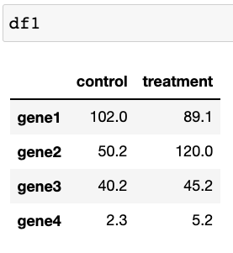
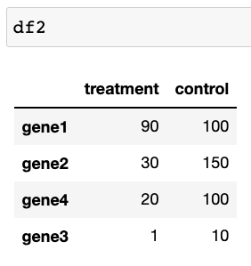
Combine DataFrames
pd.concat (objs, axis=0, join=‘outer’)

Slide 36
Combine DataFrames
pd.concat (objs, axis=0, join=‘outer’)
combine dataframes together along an axis — either the row axis or column axis.

Slide 37
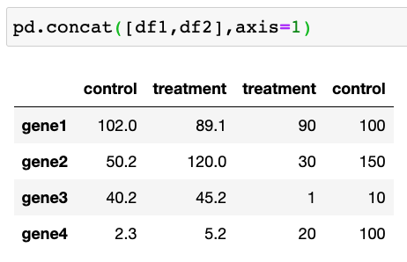
Combine DataFrames
pd.concat (objs, axis=0, join=‘outer’)

Slide 38
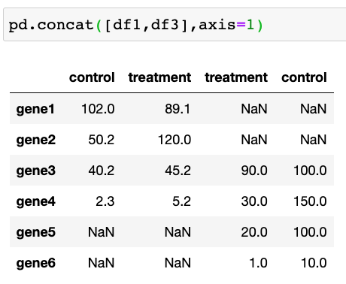
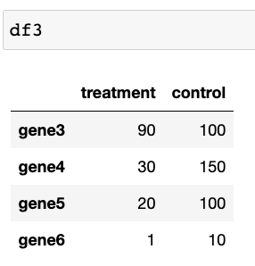
Combine DataFrames
pd.concat (objs, axis=0, join=‘outer’)

Slide 39
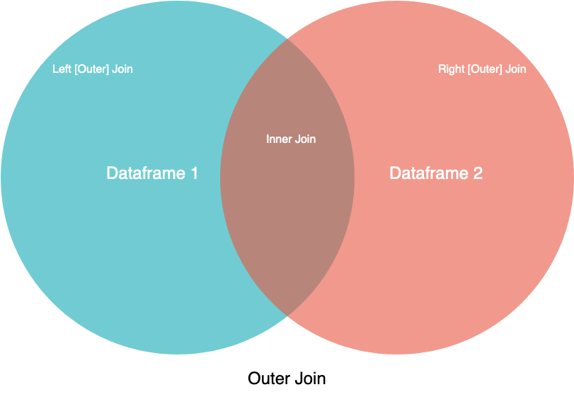
Combine DataFrames
pd.concat (objs, axis=0, join=‘outer’)

Slide 40
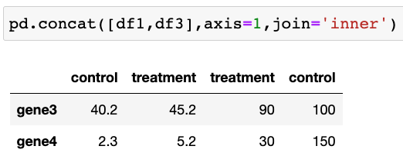
Combine DataFrames
pd.concat (objs, axis=0, join=‘outer’)

Slide 41
Combine DataFrames
2. pd.merge (left, right, how = ‘inner’, on=None, left_on = None, right_on = None,
left_index = False, right_index = False, suffixes = (‘_x’, ‘_y’) )
Merge DataFrames on specific columns.
left, right: DataFrames to merge
how: {'left', 'right', 'outer', 'inner’}, default 'inner'
on: label names to join on. These must be found in both DataFrames
left_on: Column names to join on in the left DataFrame.
right_on: Column names to join on in the right DataFrame
left_index: Use the index from the left DataFrame for merging; default False
right_index: Use the index from the left DataFrame for merging; default False
suffixes : tuple of (str, str), default ('_x', '_y’)
Suffix to apply to overlapping column names in the left and right side, respectively.

Slide 42



Combine DataFrames
2. pd.merge (left, right, how = ‘inner’, on=None, left_on = None, right_on = None,
left_index = False, right_index = False, suffixes = (‘_x’, ‘_y’) )
Merge DataFrames on one column.

Slide 43

Combine DataFrames
2. pd.merge (left, right, how = ‘inner’, on=None, left_on = None, right_on = None,
left_index = False, right_index = False, suffixes = (‘_x’, ‘_y’) )
Merge DataFrames on one column.

Slide 44

Pandas-DataFrame
2. pd.merge (left, right, how = ‘inner’, on=None, left_on = None, right_on = None,
left_index = False, right_index = False, suffixes = (‘_x’, ‘_y’) )
Merge DataFrames on one column.

Slide 45


Pandas-DataFrame
2. pd.merge (left, right, how = ‘inner’, on=None, left_on = None, right_on = None,
left_index = False, right_index = False, suffixes = (‘_x’, ‘_y’) )
Merge DataFrames on multiple columns.

Slide 46

Pandas-DataFrame
2. pd.merge (left, right, how = ‘inner’, on=None, left_on = None, right_on = None,
left_index = False, right_index = False, suffixes = (‘_x’, ‘_y’) )
Merge DataFrames on multiple columns.

